Slide 1


Clustering
15
PART IV · LEARNING WITHOUT FULL LABELS
CHAPTER 15 · WEEK 13
Machine Learning — From Hypotheses to Decisions
LECTURER
Dr. Mustafa Hameed
THE ISLAMIA UNIVERSITY OF BAHAWALPUR
Bahawalpur, Pakistan
Department of Information Technology · BSIT · Fall 2026
Notes:
Chapter 15: Clustering. Part 4 — Learning Without Full Labels. Week 13: Clustering; PCA and self-organizing maps. Handout pages 115–120.

Slide 2

Where this chapter sits
THE COURSE
PART I
PART II
PART III
PART IV
PART V
PART VI
1
2
3
4
5
6
7
8
9
10
11
12
13
14
15
16
17
18
19
20
21
22
Clustering
BUILDS ON
USED LATER IN
Ch 2 Mathematics for Machine Learning
Ch 16 Dimensionality Reduction and Self-Organizing Maps
Ch 3 The Machine Learning Workflow and Toolkit
Ch 17 Semi-Supervised Learning and the EM Algorithm
Ch 11 Instance-Based Learning: k-Nearest Neighbours
Machine Learning · Chapter 15 · Clustering
Handout p. 115 2
Notes:
Place the chapter. Before you start: Chapter 2 (distance), Chapter 3 (scaling) and Chapter 11 (distance measures and the curse of dimensionality, which clustering inherits in full).

Slide 3

What you will be able to do
LEARNING OUTCOMES
By the end of this chapter you will be able to:
1
Explain what clustering is for, and why its answer depends on choices the analyst makes.
2
Trace k-means by hand through assignment and update steps to convergence.
3
Build a dendrogram by hierarchical agglomerative clustering under single, complete and average linkage.
4
Choose the number of clusters with the elbow method and the silhouette coefficient.
5
Evaluate a clustering internally and, when labels exist, externally.
Machine Learning · Chapter 15 · Clustering
Handout p. 115 3
Notes:
Read these out: they are the chapter's contract with the room. Each click adds one.

Slide 4

Vocabulary for this chapter
KEY TERMS
clustering
partitional vs. hierarchical
centroid
k-means (Lloyd’s algorithm)
within-cluster sum of squares (WCSS)
local minimum
k-means++
agglomerative clustering
dendrogram
single, complete, average and Ward linkage
chaining
elbow method
silhouette coefficient
adjusted Rand index
Each term is defined where it first matters — not here.
Machine Learning · Chapter 15 · Clustering
Handout p. 115 4
Notes:
Do not define these now; they arrive one at a time. This slide is for the students' notes. Terms: clustering; partitional vs. hierarchical; centroid; k-means (Lloyd’s algorithm); within-cluster sum of squares (WCSS); local minimum; k-means++; agglomerative clustering; dendrogram; single, complete, average and Ward linkage; chaining; elbow method; silhouette coefficient; adjusted Rand index.

Slide 5
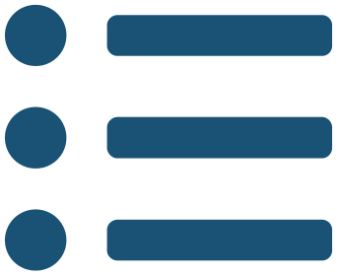
In this chapter
IN THIS CHAPTER
15.1
Finding Groups Without Labels
p. 115 ›
15.2
k-Means
p. 115 ›
15.3
Hierarchical Agglomerative Clustering
p. 117 ›
15.4
How Many Clusters?
p. 118 ›
15.5
Beyond the HEC Outline
p. 118 ›
Machine Learning · Chapter 15 · Clustering
Handout pp. 115–120 5
Notes:
The route through the chapter. Each row is a link: click it to jump to that section in the slide show.

Slide 6

Finding Groups Without Labels
KEY IDEA
Clustering divides examples into groups — clusters — so that examples in the same group are similar and examples in different groups are not. There are no labels to learn from and no right answer to check against. What counts as “similar” is a choice (of features, their scaling and a distance), and so is the number of groups; change either and the clusters change.
That makes clustering exploratory: a way of proposing structure for a person to examine. Customer segments, kinds of network traffic, families of malware, modes in which a machine operates — each is a clustering that someone then named and decided was useful. Two families of algorithm cover the HEC outline: partitional methods such as k-means divide the data into a fixed number of groups; hierarchical methods build a whole tree of nested groupings.
Machine Learning · Chapter 15 · Clustering
§15.1 · Handout p. 115 6
Notes:
Say this in your own words first; the slide is the handout's wording.

Slide 7
k-Means
SECTION 2 OF 5
15.2
15.1 Finding Groups Without Labels
15.2 k-Means
15.3 Hierarchical Agglomerative Clustering
15.4 How Many Clusters?
15.5 Beyond the HEC Outline
Machine Learning · Chapter 15
Handout §15.2 7
Notes:
Pause. Name the question this section answers.

Slide 8


k-Means (Lloyd’s Algorithm)
DEFINITION
Choose k and place k initial centroids. Repeat until nothing changes:
1. Assign each example to its nearest centroid.
2. Update each centroid to the mean of the examples assigned to it.
Each step can only lower the within-cluster sum of squares
so the algorithm always converges — but to a local minimum that depends on where it started.
Machine Learning · Chapter 15 · Clustering
§15.2 · Handout p. 115 8
Notes:
Read the box aloud, then ask for an example from the room before moving on.

Slide 9

k-Means by Hand
WORKED EXAMPLE
Seven points: A1 (1, 1), A2 (1.5, 2), A3 (3, 4), A4 (5, 7), A5 (3.5, 5), A6 (4.5, 5), A7 (3.5, 4.5). k = 2, with initial centroids A2 and A4.
Iteration 1 — assign. Distances to μ₁ = (1.5, 2) and μ₂ = (5, 7): A1 1.12 / 7.21; A2 0 / 6.10; A3 2.50 / 3.61; A4 6.10 / 0; A5 3.61 / 2.50; A6 4.24 / 2.06; A7 3.20 / 2.92. So C₁ = {A1, A2, A3}, C₂ = {A4, A5, A6, A7}.
Update. μ₁ = ((1+1.5+3)/3, (1+2+4)/3) = (1.83, 2.33); μ₂ = ((5+3.5+4.5+3.5)/4, (7+5+5+4.5)/4) = (4.13, 5.38). WCSS = 12.21.
Iteration 2 — assign. A3 is now 2.03 from μ₁ and 1.78 from μ₂: it moves to C₂. Every other point stays.
Update. μ₁ = (1.25, 1.5), μ₂ = (3.9, 5.1). WCSS = 8.53.
Iteration 3. No point changes cluster, so the centroids stop moving: converged, with C₁ = {A1, A2} and C₂ = {A3, …, A7}.
Machine Learning · Chapter 15 · Clustering
§15.2 · Handout p. 115 9
Notes:
Each click adds one step of the working. Ask for the next number before you reveal it.

Slide 10
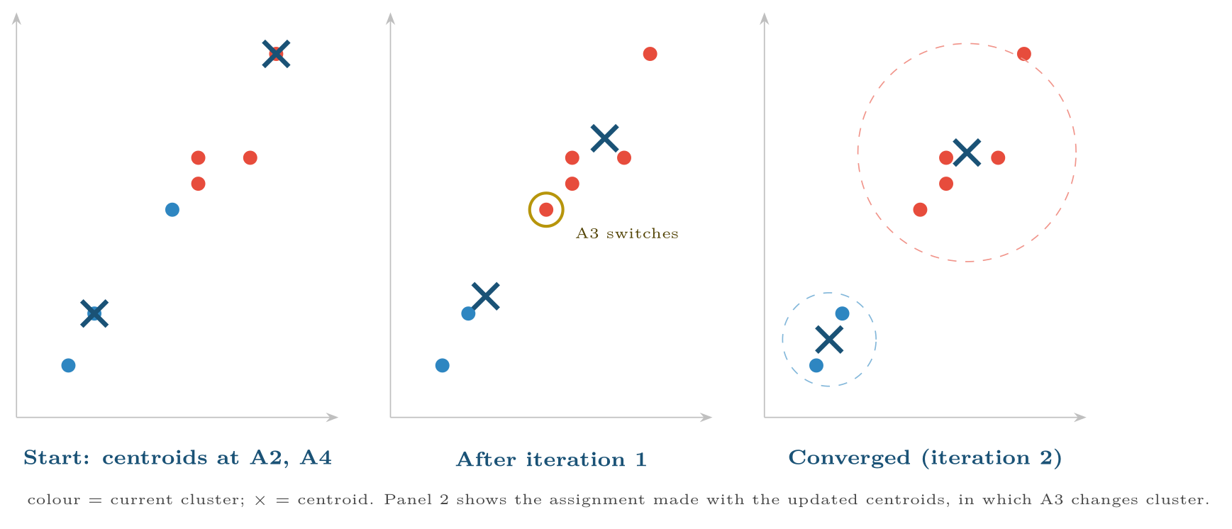
Three snapshots of k-means on the worked example
FIGURE 15.1
Assignment and update alternate until no point changes cluster.
Machine Learning · Chapter 15 · Clustering
§15.2 · Handout p. 115 10
Notes:
Figure 15.1 (handout p. 116): Three snapshots of k-means on the worked example. Assignment and update alternate until no point changes cluster.

Slide 11

Where k-Means Goes Wrong
WATCH OUT
• Bad starts. Different initial centroids can converge to different, worse clusterings. Run it many times and keep the lowest WCSS (n_init), and start with k-means++, which spreads the initial centroids out.
• Its shape bias. Every cluster is the set of points nearest a centroid, so k-means assumes round, similar-sized clusters. Long, curved or very unequal clusters are cut badly.
• Scale. It is built on Euclidean distance; unscaled features decide everything (Chapter 11).
• Outliers. A mean is pulled by extreme values; one wild point can capture a centroid of its own.
Machine Learning · Chapter 15 · Clustering
§15.2 · Handout p. 115 11
Notes:
Read the box aloud, then ask for an example from the room before moving on.

Slide 12
Hierarchical Agglomerative Clustering
SECTION 3 OF 5
15.3
15.1 Finding Groups Without Labels
15.2 k-Means
15.3 Hierarchical Agglomerative Clustering
15.4 How Many Clusters?
15.5 Beyond the HEC Outline
Machine Learning · Chapter 15
Handout §15.3 12
Notes:
Pause. Name the question this section answers.

Slide 13
Agglomerative Clustering and Linkage
DEFINITION
Start with every example in a cluster of its own. Repeatedly merge the two closest clusters until one remains. The record of merges, drawn as a tree whose heights are the merge distances, is a dendrogram. The distance between two clusters is defined by the linkage:
• single: the distance between their closest members;
• complete: the distance between their farthest members;
• average: the average distance over all pairs of members;
• Ward: the increase in WCSS that merging them would cause — the k-means criterion, applied hierarchically.
Machine Learning · Chapter 15 · Clustering
§15.3 · Handout p. 117 13
Notes:
Read the box aloud, then ask for an example from the room before moving on.

Slide 14
Single and Complete Linkage on Five Numbers
WORKED EXAMPLE
Points on a line: 1, 2, 4, 9, 11.
Single linkage. Closest pair: {1, 2} at distance 1. Next, {1, 2} to 4 is |2 − 4| = 2 and 9 to 11 is also 2: merge {1, 2, 4} and {9, 11}, both at height 2. Last, the two groups are |4 − 9| = 5 apart. Heights: 1, 2, 2, 5.
Complete linkage. {1, 2} at 1. Now {1, 2} to 4 is |1 − 4| = 3 (the farthest pair), while 9 to 11 is 2, so {9, 11} merges first, at 2; then {1, 2, 4} at 3. Last, the farthest pair across the groups is |1 − 11| = 10. Heights: 1, 2, 3, 10.
Both find the same two groups, but complete linkage separates them by a much taller final merge. Average linkage gives a final height of (8 + 10 + 7 + 9 + 5 + 7)/6 = 7.67. Cutting a dendrogram at any height yields a flat clustering: cut complete linkage anywhere between 3 and 10 and you get {1, 2, 4} and {9, 11}.
Machine Learning · Chapter 15 · Clustering
§15.3 · Handout p. 117 14
Notes:
Each click adds one step of the working. Ask for the next number before you reveal it.

Slide 15
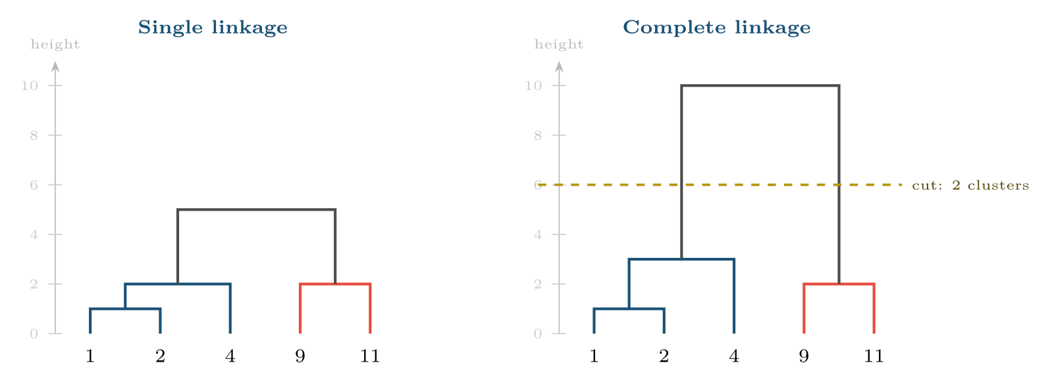
Dendrograms for the points 1, 2, 4, 9, 11
FIGURE 15.2
The merges happen in almost the same order, but at different heights: complete linkage keeps groups compact and makes the gap between them obvious.
Machine Learning · Chapter 15 · Clustering
§15.3 · Handout p. 117 15
Notes:
Figure 15.2 (handout p. 117): Dendrograms for the points 1, 2, 4, 9, 11. The merges happen in almost the same order, but at different heights: complete linkage keeps groups compact and makes the gap between them obvious.

Slide 16

Chaining, and Which Linkage to Use
CONCEPT
Single linkage merges two clusters as soon as any pair of their members is close, so a thin line of points can join two genuinely separate groups into one long “chain”. That lets it find elongated or curved clusters, and also makes it fragile with noise. Complete linkage does the opposite: it favours compact, roughly equal clusters and is pulled by outliers. Average linkage sits between them. Ward’s method behaves like k-means and is a good default. Unlike k-means, hierarchical clustering needs no k in advance and gives the same answer every run — but it must compute all n² pairwise distances, which limits it to tens of thousands of examples.
Machine Learning · Chapter 15 · Clustering
§15.3 · Handout p. 117 16
Notes:
Read the box aloud, then ask for an example from the room before moving on.

Slide 17
How Many Clusters?
SECTION 4 OF 5
15.4
15.1 Finding Groups Without Labels
15.2 k-Means
15.3 Hierarchical Agglomerative Clustering
15.4 How Many Clusters?
15.5 Beyond the HEC Outline
Machine Learning · Chapter 15
Handout §15.4 17
Notes:
Pause. Name the question this section answers.

Slide 18
How Many Clusters?
IN BRIEF
The silhouette. For each example, let a be its mean distance to the other members of its own cluster and b its mean distance to the members of the nearest other cluster. Its silhouette is
Machine Learning · Chapter 15 · Clustering
§15.4 · Handout p. 118 18
Notes:
The elbow method. Plot WCSS against k. WCSS always falls as k rises — with k = n it is zero — so look for the elbow, the k after which extra clusters buy little. The silhouette. For each example, let a be its mean distance to the other members of its own cluster and b its mean distance to the members of the nearest other cluster. Its silhouette is

Slide 19
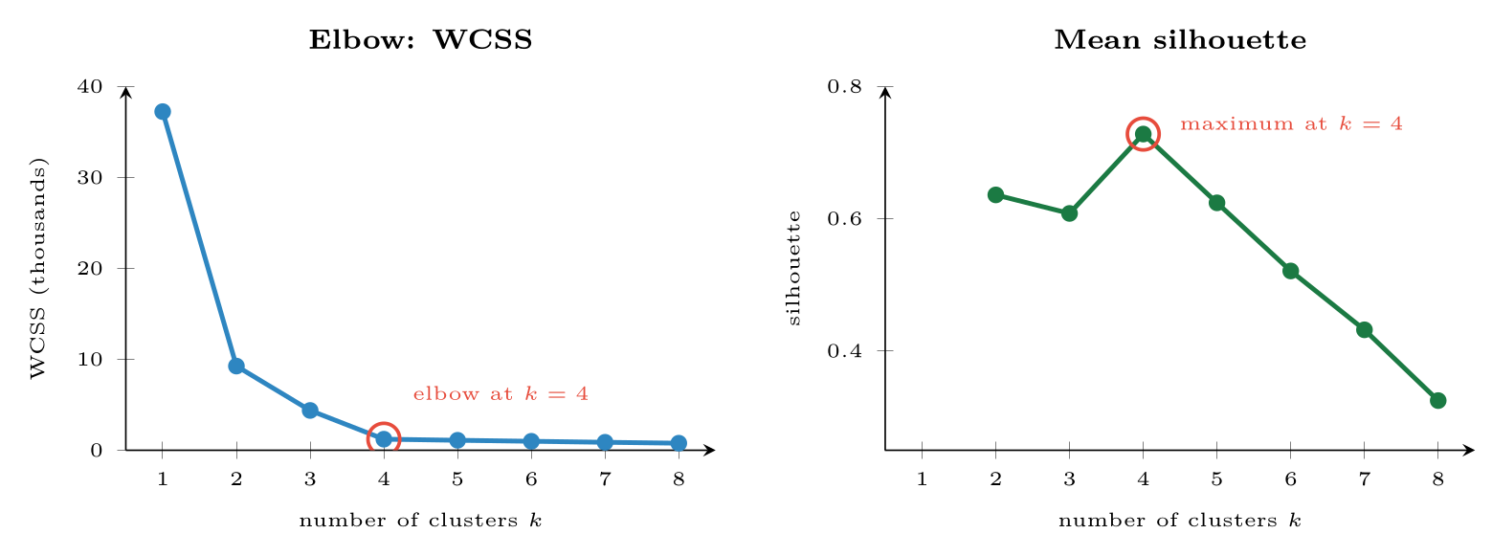
Choosing k for 600 points generated from four clusters
FIGURE 15.3
The WCSS curve bends sharply at k = 4 and the silhouette peaks there: both agree with the truth.
Machine Learning · Chapter 15 · Clustering
§15.4 · Handout p. 118 19
Notes:
Near 1: well inside its cluster. Near 0: on a boundary. Negative: probably in the wrong cluster. The mean silhouette over all examples scores a whole clustering; pick the k that maximises it. A point with a = 2 and b = 6 has s = (6 − 2)/6 = 0.67.
Figure 15.3 (handout p. 118): Choosing k for 600 points generated from four clusters. The WCSS curve bends sharply at k = 4 and the silhouette peaks there: both agree with the truth.

Slide 20
Judging a Clustering
WATCH OUT
Internal measures (WCSS, silhouette) use only the data, and reward whatever shape the measure assumes. External measures such as the adjusted Rand index compare the clusters with known labels, when some exist: 1 for perfect agreement, about 0 for chance. The most important test is neither: can a domain expert name the clusters, and do the names lead to a different decision for each? A clustering nobody can use is not a result.
Machine Learning · Chapter 15 · Clustering
§15.4 · Handout p. 118 20
Notes:
Read the box aloud, then ask for an example from the room before moving on.

Slide 21

Common pitfalls
COMMON PITFALLS
✕
Clustering unscaled features. The feature with the largest units decides the clusters.
✕
Running k-means once. Use many starts and k-means++.
✕
Choosing k by WCSS alone. It always falls; look for the elbow and check the silhouette.
✕
Treating clusters as discovered facts. They reflect the features, scaling, distance and k chosen; a different choice gives different clusters.
✕
Forcing k-means onto non-round clusters. Use single linkage, DBSCAN or a mixture model instead.
Machine Learning · Chapter 15 · Clustering
§15.5 · Handout p. 118 21
Notes:
For each pitfall, ask who has seen it happen. One real story beats five bullets.

Slide 22





Four lenses: Clustering
FOUR LENSES
LEARNING ANALYTICS
PROJECT MANAGEMENT
Cluster students by how they study — when they log in, how they use videos and quizzes — and advisers can tailor support to “last-minute crammers” or “steady early starters”.
Clustering past projects on size, duration, team and technology yields project archetypes, each with its own typical overrun.
INTERNET OF THINGS
CYBERSECURITY
Clustering a machine’s sensor readings recovers its operating modes — idle, normal load, heavy load — without anyone labelling them.
Clustering malware by behaviour groups new samples into families, so analysts examine one sample per cluster instead of thousands.
Machine Learning · Chapter 15 · Clustering
Handout p. 120 22
Notes:
The same method, four domains. Each of the next four slides opens one lens in full.

Slide 23

Learning Analytics: Clustering
FOUR LENSES
LEARNING ANALYTICS
Project Management
Cluster students by how they study — when they log in, how they use videos and quizzes — and advisers can tailor support to “last-minute crammers” or “steady early starters”. The names come from people looking at the clusters, and the clusters change if you add or remove a behavioural feature.
Internet of Things
Cybersecurity
Machine Learning · Chapter 15 · Clustering
Handout p. 120 23
Notes:
Learning Analytics. Cluster students by how they study — when they log in, how they use videos and quizzes — and advisers can tailor support to “last-minute crammers” or “steady early starters”. The names come from people looking at the clusters, and the clusters change if you add or remove a behavioural feature.

Slide 24

Project Management: Clustering
FOUR LENSES
PROJECT MANAGEMENT
Learning Analytics
Clustering past projects on size, duration, team and technology yields project archetypes, each with its own typical overrun. A new project is estimated from its archetype — nearest-centroid classification built from an unsupervised start.
Internet of Things
Cybersecurity
Machine Learning · Chapter 15 · Clustering
Handout p. 120 24
Notes:
Project Management. Clustering past projects on size, duration, team and technology yields project archetypes, each with its own typical overrun. A new project is estimated from its archetype — nearest-centroid classification built from an unsupervised start.

Slide 25

Internet of Things: Clustering
FOUR LENSES
INTERNET OF THINGS
Learning Analytics
Clustering a machine’s sensor readings recovers its operating modes — idle, normal load, heavy load — without anyone labelling them. A reading far from every centroid is a candidate anomaly; one that drifts from its mode’s centroid over weeks is wear.
Project Management
Cybersecurity
Machine Learning · Chapter 15 · Clustering
Handout p. 120 25
Notes:
Internet of Things. Clustering a machine’s sensor readings recovers its operating modes — idle, normal load, heavy load — without anyone labelling them. A reading far from every centroid is a candidate anomaly; one that drifts from its mode’s centroid over weeks is wear.

Slide 26

Cybersecurity: Clustering
FOUR LENSES
CYBERSECURITY
Learning Analytics
Clustering malware by behaviour groups new samples into families, so analysts examine one sample per cluster instead of thousands. Network traffic clusters separate normal services; a small, tight new cluster appearing overnight deserves attention.
Project Management
Internet of Things
Machine Learning · Chapter 15 · Clustering
Handout p. 120 26
Notes:
Cybersecurity. Clustering malware by behaviour groups new samples into families, so analysts examine one sample per cluster instead of thousands. Network traffic clusters separate normal services; a small, tight new cluster appearing overnight deserves attention.

Slide 27

Try it yourself: k-Means, a Dendrogram and the Choice of k
TRY IT YOURSELF
WHAT YOU WILL DO
1. The worked example: k-means from A2 and A4
2. Choosing k: the elbow and the silhouette
3. Hierarchical clustering: linkage heights on five numbers
4. Against the truth, and why scale matters
THIS WEEK'S LAB
WHAT YOU WILL RUN
RUNNABLE COPY
Week 13: k-means and a dendrogram; PCA and a SOM
1 listing, 46 lines of Python
code/ch15_k_means_dendrogram.py
Machine Learning · Chapter 15 · Clustering
§15.5 · Handout p. 118 27
Notes:
Say what the room will have at the end of the lab, then let them start. Circulate rather than lecture.

Slide 28
k-Means, a Dendrogram and the Choice of k
LAB · STEP 1 OF 5
Set-up
Python · code/ch15_k_means_dendrogram.py
2
3
4
5
6
7
8
9
10
import warnings
import numpy as np
from scipy.cluster.hierarchy import linkage, fcluster
from sklearn.datasets import make_blobs
from sklearn.cluster import KMeans, AgglomerativeClustering
from sklearn.metrics import silhouette_score, adjusted_rand_score
from sklearn.preprocessing import StandardScaler
warnings.filterwarnings("ignore", message="KMeans is known to have a memory")
Machine Learning · Chapter 15 · Clustering
§15.5 · Handout p. 118 28
Notes:
Step 1: Set-up. Read the code aloud; ask what each line would print before running it.

Slide 29
k-Means, a Dendrogram and the Choice of k
LAB · STEP 2 OF 5
The worked example: k-means from A2 and A4
Python · code/ch15_k_means_dendrogram.py
12
13
14
15
16
17
# --- 1. the worked example: k-means from A2 and A4 -----------------------
P = np.array([[1, 1], [1.5, 2], [3, 4], [5, 7], [3.5, 5], [4.5, 5],
[3.5, 4.5]])
km = KMeans(n_clusters=2, init=P[[1, 3]], n_init=1).fit(P)
print("centroids:", km.cluster_centers_.round(3).tolist(),
" WCSS:", round(km.inertia_, 3), " iterations:", km.n_iter_)
Machine Learning · Chapter 15 · Clustering
§15.5 · Handout p. 118 29
Notes:
Step 2: The worked example: k-means from A2 and A4. Read the code aloud; ask what each line would print before running it.

Slide 30
k-Means, a Dendrogram and the Choice of k
LAB · STEP 3 OF 5
Choosing k: the elbow and the silhouette
Python · code/ch15_k_means_dendrogram.py
19
20
21
22
23
24
25
# --- 2. choosing k: the elbow and the silhouette -------------------------
X, truth = make_blobs(n_samples=600, centers=4, cluster_std=1.0,
random_state=3)
for k in range(2, 8):
m = KMeans(n_clusters=k, n_init=10, random_state=0).fit(X)
print(f"k={k}: WCSS {m.inertia_:8.1f} "
f"silhouette {silhouette_score(X, m.labels_):.3f}")
Machine Learning · Chapter 15 · Clustering
§15.5 · Handout p. 118 30
Notes:
Step 3: Choosing k: the elbow and the silhouette. Read the code aloud; ask what each line would print before running it.

Slide 31
k-Means, a Dendrogram and the Choice of k
LAB · STEP 4 OF 5
Hierarchical clustering: linkage heights on five numbers
Python · code/ch15_k_means_dendrogram.py
27
28
29
30
31
32
33
# --- 3. hierarchical clustering: linkage heights on five numbers ---------
x = np.array([[1.0], [2.0], [4.0], [9.0], [11.0]])
for method in ("single", "complete", "average"):
Z = linkage(x, method)
print(f"{method:8s} merge heights: {Z[:, 2].round(2).tolist()}")
print("complete linkage cut into 2 groups:",
fcluster(linkage(x, "complete"), 2, criterion="maxclust").tolist())
Machine Learning · Chapter 15 · Clustering
§15.5 · Handout p. 118 31
Notes:
Step 4: Hierarchical clustering: linkage heights on five numbers. Read the code aloud; ask what each line would print before running it.

Slide 32
k-Means, a Dendrogram and the Choice of k
LAB · STEP 5 OF 5
Against the truth, and why scale matters
Python · code/ch15_k_means_dendrogram.py
35
36
37
38
39
40
41
42
43
44
45
46
47
# --- 4. against the truth, and why scale matters -------------------------
km4 = KMeans(4, n_init=10, random_state=0).fit_predict(X)
hac = AgglomerativeClustering(n_clusters=4, linkage="ward").fit(X)
print("adjusted Rand, k-means:", round(adjusted_rand_score(truth, km4), 3),
" ward HAC:", round(adjusted_rand_score(truth, hac.labels_), 3))
Xs = X.copy()
Xs[:, 1] *= 100 # one feature in other units
raw = KMeans(4, n_init=10, random_state=0).fit_predict(Xs)
fix = KMeans(4, n_init=10, random_state=0).fit_predict(
StandardScaler().fit_transform(Xs))
print("rescaled feature, adjusted Rand: raw",
round(adjusted_rand_score(truth, raw), 3), " standardised",
round(adjusted_rand_score(truth, fix), 3))
Machine Learning · Chapter 15 · Clustering
§15.5 · Handout p. 118 32
Notes:
Step 5: Against the truth, and why scale matters. Read the code aloud; ask what each line would print before running it.

Slide 33
What the lab shows
TRY IT YOURSELF
The warning filter hides a harmless message scikit-learn prints on some Windows installations. Change cluster_std to 2.5 in part 2: do the elbow and the silhouette still agree?
Machine Learning · Chapter 15 · Clustering
§15.5 · Handout p. 118 33
Notes:
Read the box aloud, then ask for an example from the room before moving on.

Slide 34

Two centroids are at 2 and 8 on a line. Assign the points 1, 4, 6, 7, 9 and compute the new centroids.
CHECKPOINT 1 OF 3
Discuss with the person next to you, then advance.
Machine Learning · Chapter 15 · Clustering
Handout p. 120 · answers in Appendix D 34
Notes:
Ask the room. Do not advance until someone commits to an answer.

Slide 35

Two centroids are at 2 and 8 on a line. Assign the points 1, 4, 6, 7, 9 and compute the new centroids.
CHECKPOINT 1 OF 3 · ANSWER
1 and 4 go to 2; 6, 7 and 9 go to 8. New centroids: (1 + 4)/2 = 2.5 and (6 + 7 + 9)/3 = 7.33.
Machine Learning · Chapter 15 · Clustering
Handout p. 120 · answers in Appendix D 35
Notes:
Answer (Appendix D): 1 and 4 go to 2; 6, 7 and 9 go to 8. New centroids: (1 + 4)/2 = 2.5 and (6 + 7 + 9)/3 = 7.33.

Slide 36
Why does k-means always converge, and why might it converge to a poor answer?
CHECKPOINT 2 OF 3
Discuss with the person next to you, then advance.
Machine Learning · Chapter 15 · Clustering
Handout p. 120 · answers in Appendix D 36
Notes:
Ask the room. Do not advance until someone commits to an answer.

Slide 37
Why does k-means always converge, and why might it converge to a poor answer?
CHECKPOINT 2 OF 3 · ANSWER
Neither step can increase the WCSS and there are finitely many possible assignments, so it must stop. But it stops at a local minimum that depends on the starting centroids.
Machine Learning · Chapter 15 · Clustering
Handout p. 120 · answers in Appendix D 37
Notes:
Answer (Appendix D): Neither step can increase the WCSS and there are finitely many possible assignments, so it must stop. But it stops at a local minimum that depends on the starting centroids.

Slide 38
A point has a = 3 and b = 2. Compute its silhouette and say what it means.
CHECKPOINT 3 OF 3
Discuss with the person next to you, then advance.
Machine Learning · Chapter 15 · Clustering
Handout p. 120 · answers in Appendix D 38
Notes:
Ask the room. Do not advance until someone commits to an answer.

Slide 39
A point has a = 3 and b = 2. Compute its silhouette and say what it means.
CHECKPOINT 3 OF 3 · ANSWER
s = (2 − 3)/3 = −0.33. The point is, on average, closer to another cluster than to its own: it is probably in the wrong cluster.
Machine Learning · Chapter 15 · Clustering
Handout p. 120 · answers in Appendix D 39
Notes:
Answer (Appendix D): s = (2 − 3)/3 = −0.33. The point is, on average, closer to another cluster than to its own: it is probably in the wrong cluster.

Slide 40

What to take away
CHAPTER SUMMARY
1
Clustering proposes groups without labels; the result depends on features, scaling, distance and the number of clusters.
2
k-means alternates assignment to the nearest centroid with moving each centroid to its cluster’s mean, lowering WCSS until it converges to a local minimum; use many starts and k-means++.
3
Agglomerative clustering merges the closest clusters step by step into a dendrogram; the linkage (single, complete, average, Ward) defines “closest”. Single linkage chains; complete linkage keeps groups compact.
4
Choose k with the elbow of the WCSS curve and the maximum mean silhouette; judge the result by whether it can be named and used.
Machine Learning · Chapter 15 · Clustering
Handout p. 120 40
Notes:
Ask the room to say each takeaway before you reveal it.

Slide 41

Quick check 1 of 3
REVIEW · MULTIPLE CHOICE
The k-means update step moves each centroid to:
A
the median of its cluster
B
the mean of its cluster
C
the farthest point
D
a random point
Machine Learning · Chapter 15 · Clustering
Handout p. 120 41
Notes:
Take a show of hands for each option before discussing. (The handout does not print MCQ answers.)

Slide 42
Quick check 2 of 3
REVIEW · MULTIPLE CHOICE
Which linkage is most prone to chaining?
A
single
B
complete
C
average
D
Ward
Machine Learning · Chapter 15 · Clustering
Handout p. 120 42
Notes:
Take a show of hands for each option before discussing. (The handout does not print MCQ answers.)

Slide 43
Quick check 3 of 3
REVIEW · MULTIPLE CHOICE
A silhouette close to −1 suggests the point is:
A
well clustered
B
on a boundary
C
probably in the wrong cluster
D
an outlier with no cluster
Machine Learning · Chapter 15 · Clustering
Handout p. 120 43
Notes:
Take a show of hands for each option before discussing. (The handout does not print MCQ answers.)

Slide 44
For your notebook
REVIEW QUESTIONS
SHORT
Why can the WCSS alone not be used to choose k?
SHORT
Give two situations where hierarchical clustering is preferable to k-means.
SHORT
Explain the role of k-means++.
APPLIED
Run k-means by hand on the worked example with initial centroids A1 and A7. Does it reach the same final clusters?
APPLIED
Build single- and complete-linkage dendrograms for the points 0, 3, 4, 10, 12, 20 and state the two-cluster cut of each.
Machine Learning · Chapter 15 · Clustering
Handout p. 120 44
Notes:
Set these for independent study. Model answers are not printed in the handout.

Slide 45
Beyond the HEC Outline
KEY IDEA
Two methods complete the picture. DBSCAN grows clusters from dense regions and labels isolated points as noise, so it finds clusters of any shape without being told k — it belongs to the Data Mining course, with outlier detection. Gaussian mixture models replace k-means’s hard assignments by probabilities; they are fitted with the EM algorithm of Chapter 17, of which k-means turns out to be a special case.
Machine Learning · Chapter 15 · Clustering
§15.5 · Handout p. 118 45
Notes:
Say this in your own words first; the slide is the handout's wording.

Slide 46
End of Chapter 15
15
NEXT
READ
Chapter 16 — Dimensionality Reduction and Self-Organizing Maps
Handout Chapter 15, pages 115–120
THIS WEEK'S LAB
ASSESSMENT
k-means and a dendrogram; PCA and a SOM
Quiz 3 (Ch 9–14)
Machine Learning · Chapter 15 · Clustering
46
Notes:
Close. NEXT: Chapter 16 — Dimensionality Reduction and Self-Organizing Maps. READ: Handout Chapter 15, pages 115–120. THIS WEEK'S LAB: k-means and a dendrogram; PCA and a SOM. ASSESSMENT: Quiz 3 (Ch 9–14).

